Slide 1
A novel method for multiple alignment of sequences with repeated and shuffled elements
Benjamin Raphael, Degui Zhi, Haixu Tang, and Pavel Pevzner
Genome Research, 2004, Vol.14, pp.2336-2346
Presenter : Hsiao-Yen Chang
Date : April 19, 2007

Slide 2
Abstract
We describe ABA (A-Bruijn alignment), a new method for multiple alignment
of biological sequences. The major difference between ABA and existing
multiple alignment methods is that ABA represents an alignment as a
directed graph, possibly containing cycles. This representation provides
more flexibility than does a traditional alignment matrix or the recently
introduced partial order alignment (POA) graph by allowing a larger class of
evolutionary relationships between the aligned sequences. Our graph
representation is particularly well-suited to the alignment of protein
sequences with shuffled and/or repeated domain structure, and allows one
to construct multiple alignments of proteins containing (1) domains that are
not present in all proteins, (2) domains that are present in different orders in
different proteins, and (3) domains that are present in multiple copies in
some proteins. In addition, ABA is useful in the alignment of genomic
sequences that contain duplications and inversions. We provide several
examples illustrating the applications of ABA.

Slide 3
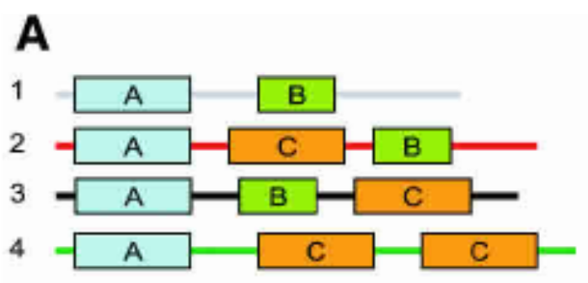
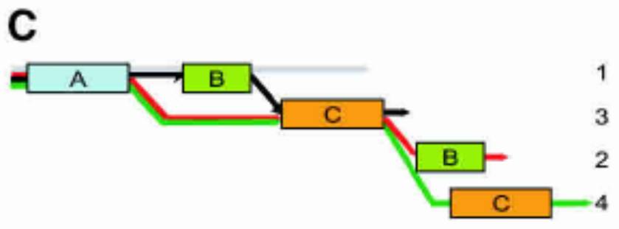
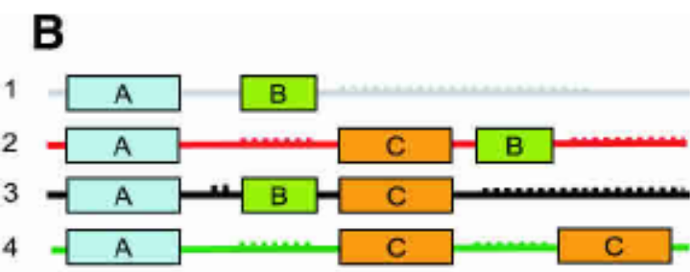
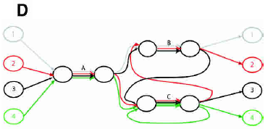
Introduction
Four “protein” sequences containing three “domains”
partial order alignment (POA)
row–column multiple alignment
ABA graph

Slide 4
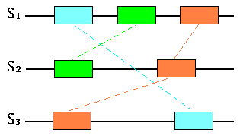
Introduction
With a row–column or partial order representation,
any local similarities that “cross” are inconsistent.
In our representation, these local similarities are
permissible and lead to cycles in the alignment.

Slide 5
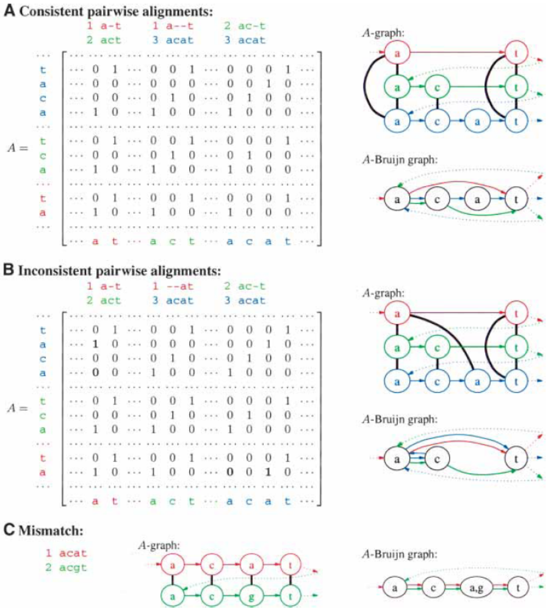

Slide 6
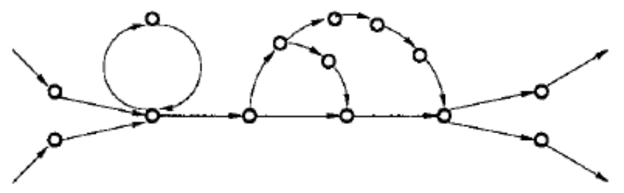
The A-Bruijn Graphs
There are two types of short cycles in the A-Bruijn graphs: whirls and bulges. Whirls are short, oriented cycles (i.e., all edges of the whirl are oriented the same way), whereas bulges are short cycles that contain both forward and reverse edges.

Slide 7
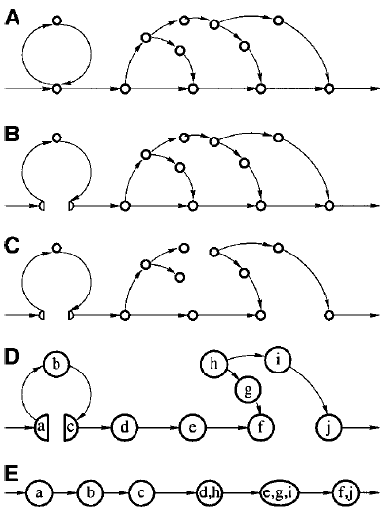
RepeatGluer Algorithm
Initial A-Bruijn graph
Construct the A-Bruijn graph from matrix A.
(B) Whirl elimination
Eliminate whirls in the A-Bruijn graph by splitting the composed vertices and modifying A accordingly.
(C) Bulge removal
Remove bulges from the A-Bruijn graph by constructing a maximum spanning tree and adding edges of the A-Bruijn graph that do not form “short” cycles with already present edges. (Cormen et al. 1989)
(D) Erosion
Perform girth iterations of the erosion procedure in the graph by removing all leaves (except source and sink) in every iteration.
(E) Zigzag path straightening

Slide 8
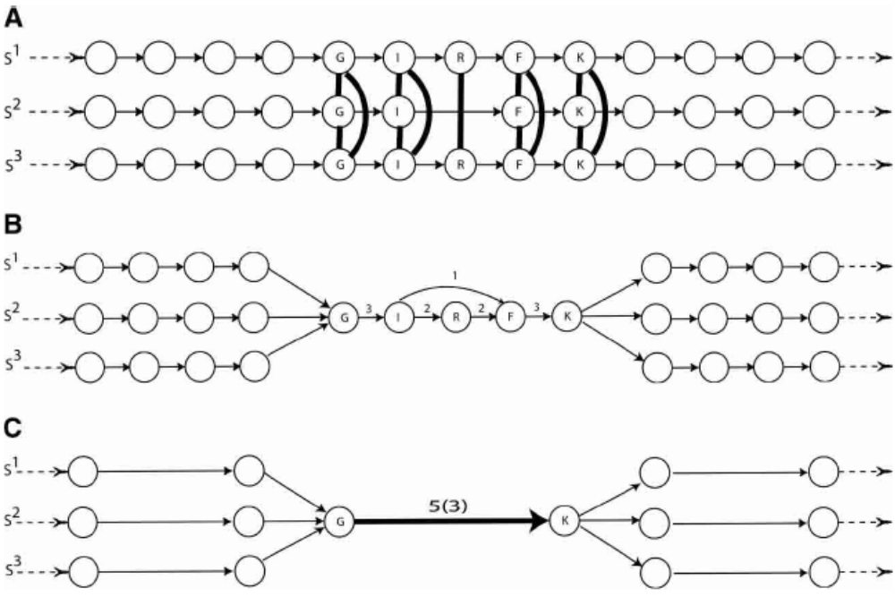
The A-Bruijn Graphs
Each multiple edge has a label of the form l(m), where l is the length of the sequences represented by that edge and m is the multiplicity of the edge.

Slide 9
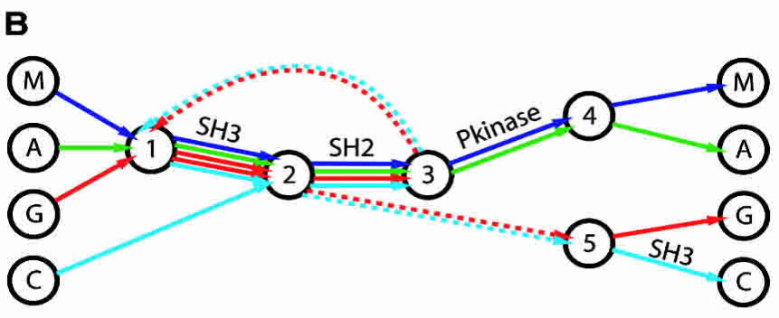
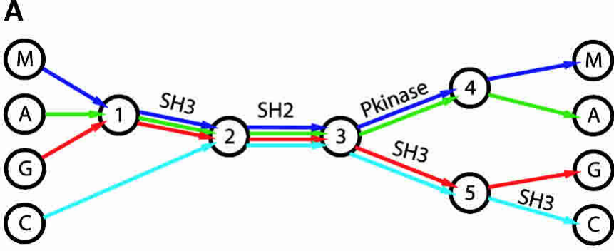
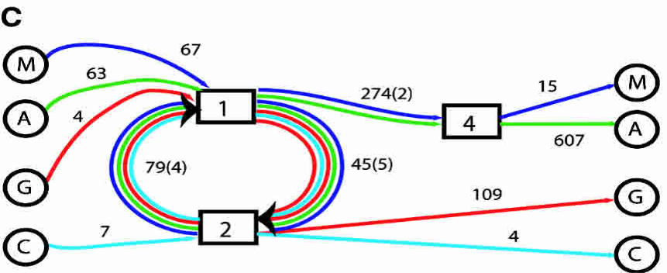
Result
45
Comparison of POA and ABA representations of the domain structure of four human SH2 domain containing proteins: MATK (M), ABL1 (A), GRB2 (G), and CRKL (C). (A) A simplified representation of the POA graph, as obtained in Lee et al. (2002). Each input sequence forms a path through the graph. Edges with a high multiplicity are labeled with protein domains. (B) A simplified representation of the ABA graph. Dotted edges have length zero and connect nodes that are glued together in the ABA graph. (C) The ABA graph with collapsed multiple edges. Boxed vertices represent small subgraphs that have been contracted (cf. Methods). In this graph, high multiplicity edges correspond to protein domains SH2, SH3, and Pkinase domains with estimated lengths of 79, 45, and 274 nucleotides, respectively.

Slide 10
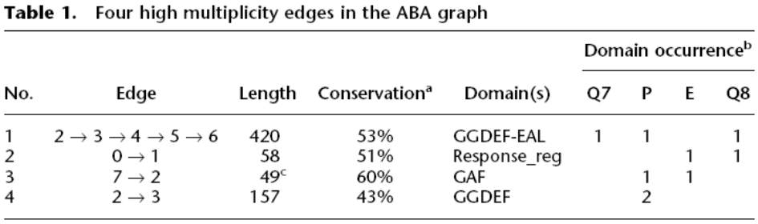
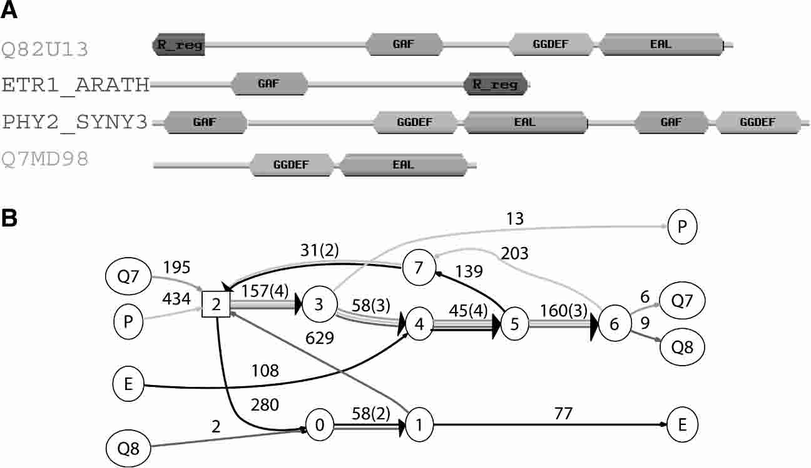
Result
POA detects either
alignment 2 or 3 in
Table 1, but not both.
Four proteins with shuffled domains and their ABA graph. (A) The domain structures are derived from the SwissPfam database (Bateman et al. 2004). We show only well-annotated PfamA domains. Domains that appear in only one of the four sequences are not shown. (B) Cycles in the ABA graph reveal the extensive domain shuffling in these sequences.

Slide 11
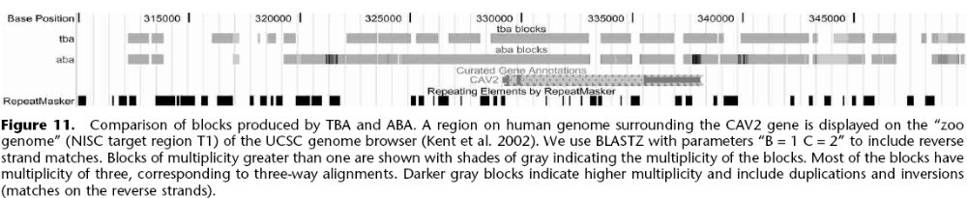
Result
First, ABA generates blocks of multiplicity higher than three , demonstrating the ability of ABA to handle duplications and inversions.
Second, TBA detects a few blocks that are missed by ABA: These blocks represent short three-way alignments. ABA misses these short alignments because it uses only pairwise alignments, whereas TBA implements a progressive multiple alignment engine (MULTIZ).
Third, ABA generally produces longer blocks.

